Slide 1
The Paradise - Hotel
- Full Stack Project by asHwini Harish Poojary

Slide 2
Introduction:
A platform designed to make hotel reservations seamless and hassle-free. With advanced search filters, real-time room availability, and a user-friendly interface, this website aim to simplify the way where customer can find and book accommodations.

Slide 3
Technology Used:
Front-end: HTML, CSS
Back-end: Python
Database: MySQL (MySQL Workbench)
Framework: Django

Slide 4
Features
Search Filters: Location, room type, price range, availability.
Real-Time Availability: Live data integration for room status.
Payment Options: Secure and diverse payment methods.
User-Friendly Interface: Simple navigation and interactive UI.

Slide 5
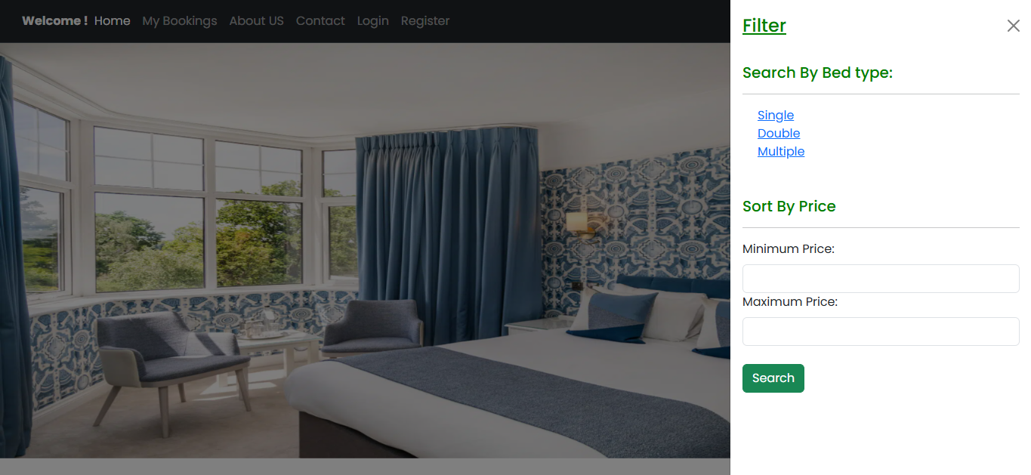
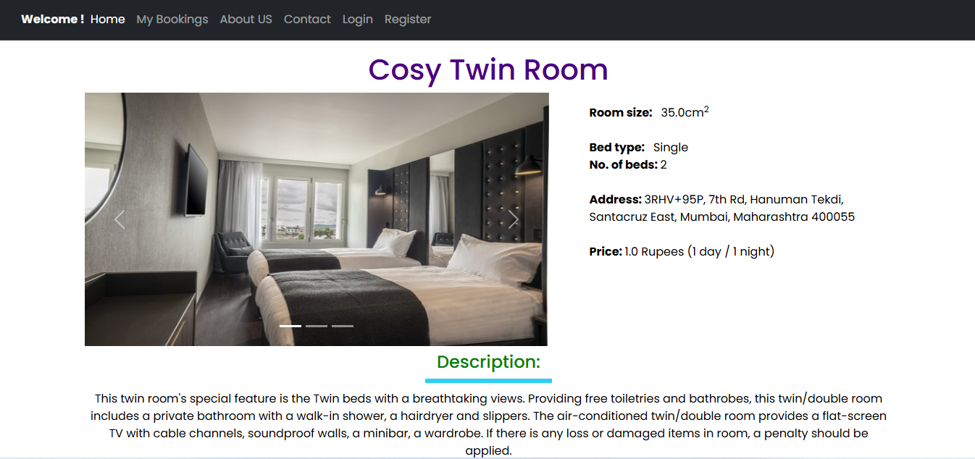
Main Page
Room details page

Slide 6
Thank You

